Slide 1

Nick James
About Me
Goals
Visual Work
Written Work
Contact
I’m a recent graduate of UFV’s Computer Information Systems degree program.
I’ve been working as a
freelance graphic artist for the past six years.
When I’m not working, I enjoy hiking, beachcombing and tennis.

Slide 2
Nick James
VOLUNTEER MY TIME
About Me
Goals
Visual Work
Written Work
Contact
build something with my bare hands
learn another language
become famous in my neighbourhood for my chocolate chip cookies
get to know my parents better
keep up with technology
own a house
help someone find their way
save money
bowl a perfect game
sing
reduce my carbon footprint
read more and watch TV less
fly kites
travel to Asia
get fit
bike to work
scuba dive
jump in puddles
keep a diary
find a job that doesn't feel like “work”
run a marathon
learn chess

Slide 3



Nick James
About Me
Goals
Visual Work
Written Work
Contact
photography
video
illustration

Slide 4

Nick James
About Me
Goals
Visual Work
Written Work
Contact
“Recurring Dream”
photography
1 | 2 | 3

Slide 5

Nick James
About Me
Goals
Visual Work
Written Work
Contact
“Enchanted”
photography
1 | 2 | 3

Slide 6
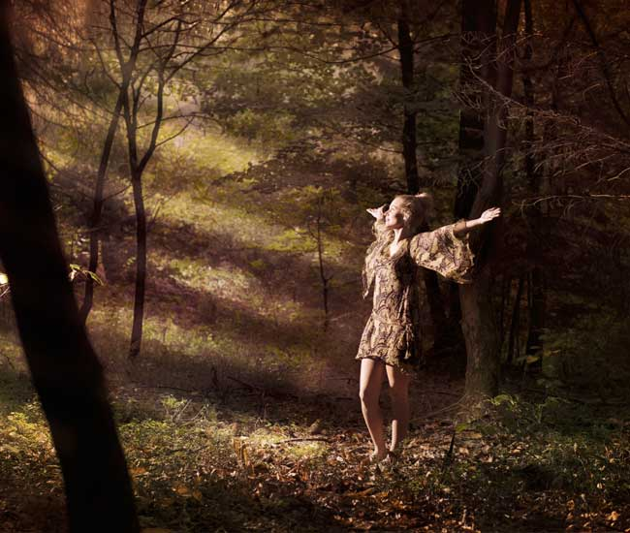
Nick James
About Me
Goals
Visual Work
Written Work
Contact
“Autumn”
photography
1 | 2 | 3

Slide 7
Nick James
About Me
Goals
Visual Work
Written Work
Contact
“Spring in Japan”
illustration
1 | 2 | 3

Slide 8

Nick James
About Me
Goals
Visual Work
Written Work
Contact
“Manipadme”
illustration
1 | 2 | 3

Slide 9
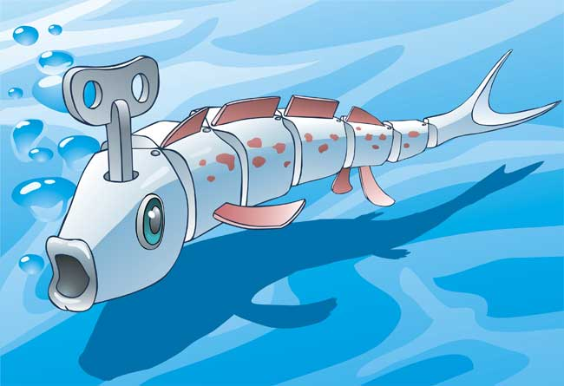
Nick James
About Me
Goals
Visual Work
Written Work
Contact
“Wind Up Fish”
illustration
1 | 2 | 3

Slide 10

Nick James
About Me
Goals
Visual Work
Written Work
Contact
play button
“The Great Escape”
video
1 | 2

Slide 11
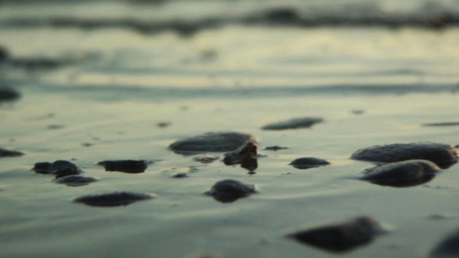
Nick James
About Me
Goals
Visual Work
Written Work
Contact
play button
“She Sells Seashells”
video
1 | 2

Slide 12

Nick James
About Me
Goals
Visual Work
Written Work
Contact
I wrote this article for a local non-profit group when they needed volunteers for a fund raising event. It was published in the UFV Cascade Newspaper
This was a short story that I wrote in an upper-level Creative Writing course
I wrote this technical documentation to go with an inventory management program that I developed for a local computer repair shop.

Slide 13
Nick James
About Me
Goals
Visual Work
Written Work
Contact
Nick James
nick.james0@student.ufv.ca

