Slide 1
Functional Resistance Training for Postmenopausal Women
The why, the challenge and the how of it
CERA 2025
Dr. Iris Lesser and Tobias Sienga

Slide 2
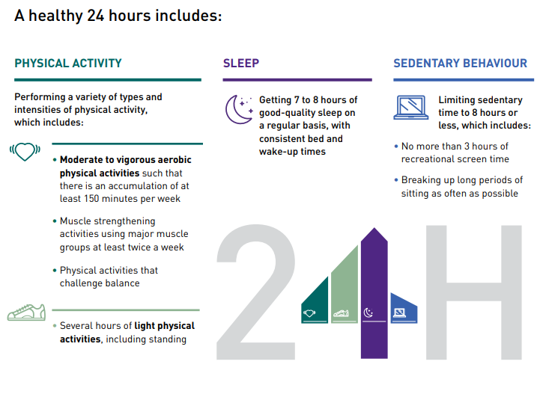
Active Aging

Slide 3
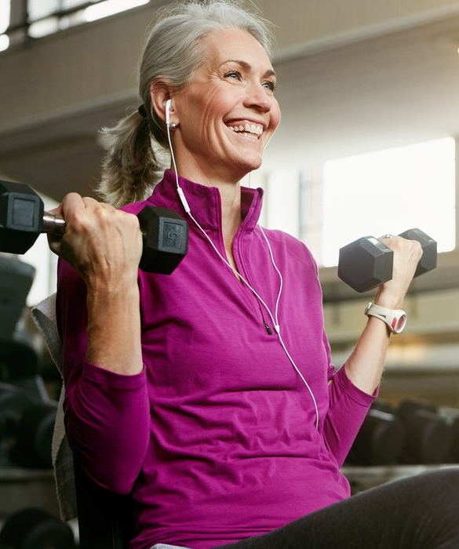
Lift something
Resistance exercise is recommended as the first-line treatment for improving muscle strength and function
Functionally, strength training is an activity in which muscles move dynamically against weight (or other resistance) with small but consistent increases in the amount of weight being lifted over time.
Done regularly, these exercises improve glucose control and body composition, build bone and muscle, and help preserve strength, independence, and vitality with age

Slide 4
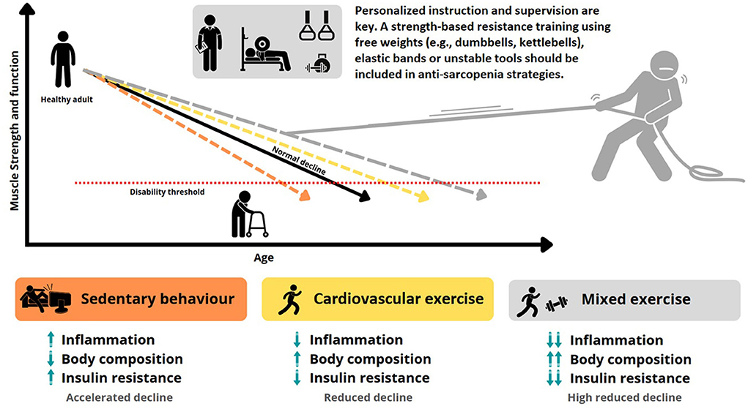
https://doi.org/10.3389/fspor.2022.950949

Slide 5
Women and ageing?
estrogen is a key ovarian hormone affecting muscle strength in women
the production of estradiol and progesterone falls at menopause, occurring at 45–52 years of age leading to strength decline
Compared to premenopausal women, cross-sectional studies have demonstrated that lean or muscle mass is lower in postmenopausal women

Slide 6
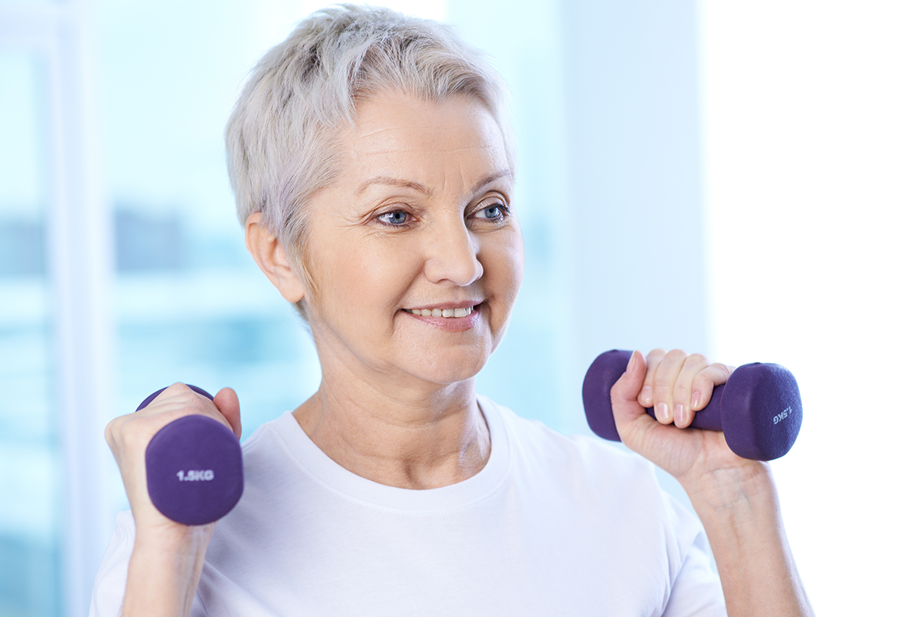
What may be misleading with this image?
CSEP Physical Activity Guidelines for Older Adults
“at least 2 days a week, older adults should do muscle-strengthening activities that involve all the major muscle groups”
Exercise dose is related to the amount of positive change

Slide 7
Working around challenges
Challenges?
  individual (e.g., poor health, pain, fear of injury)
  psychological (e.g., attitudes and health beliefs)
  social (e.g., lack of social support)
  environmental factors (e.g., lack of appropriate programmes and facilities)
  What are your biggest challenges in engaging in resistance training?

Slide 8
We’re struggling…
Despite compelling scientific research and widespread public health recommendations, among women 45–64 years and 65–74 years old, only 18% and 11%, respectively, perform physical activities that enhance and maintain muscle strength and endurance two or more times per week

Slide 9
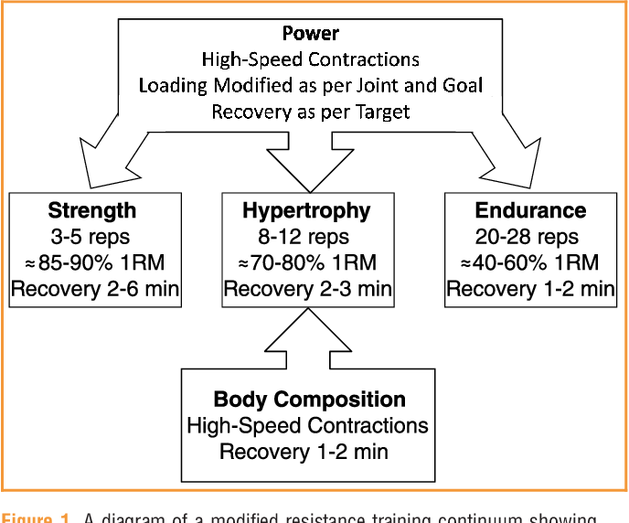
Too complicated?
Signorile, J.F. (2013). Resistance Training for Older Adults: Targeting Muscular Strength, Power, and Endurance. ACSM’s Health & Fitness Journal, 17, 24–32.

Slide 10
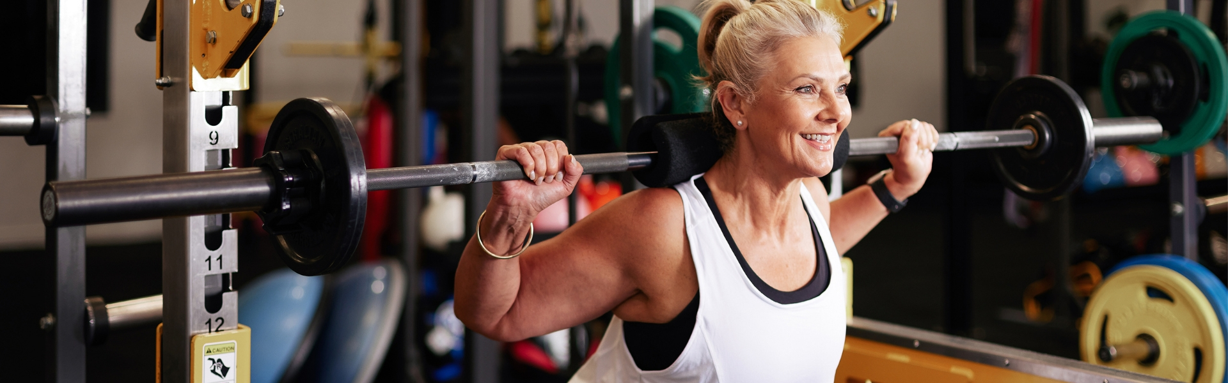
Remember:
Exercise dose is related to the amount of positive change
So, we need to challenge ourselves and we need to challenges ourselves regularly – but does it need to be more complicated than that?

Slide 11
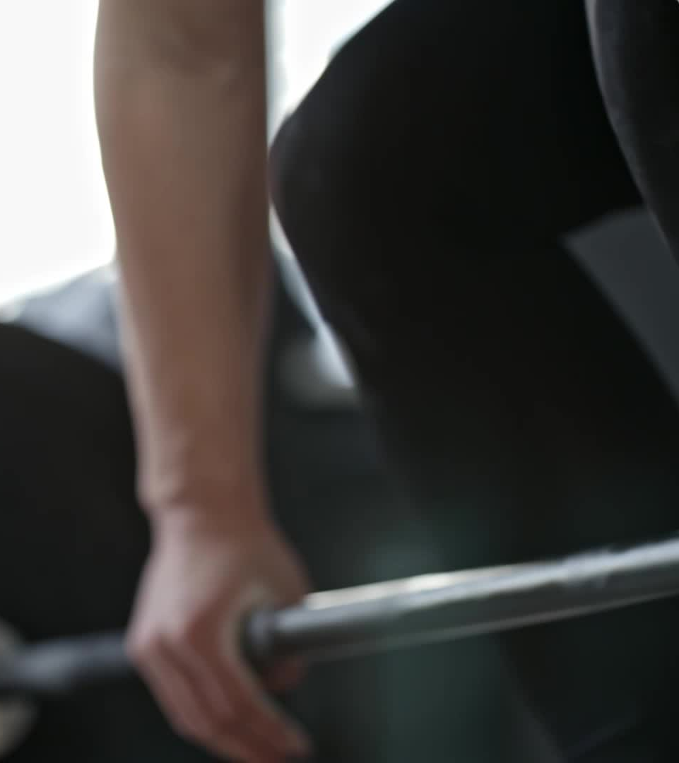
The concept of lifting
Do you consider yourself someone who engages in strength training?
What does strength training mean to you?
What does lifting heavy enough mean to you?

Slide 12
Full body strength program
(40-60 min)
Warm up
Lower-body exercises
Knee extensor exercise
Knee flexor exercise
Calf raise
Setup ups
Upper-body exercises
Wall press-ups
Shoulder raises
Seated rows
Chest pull
Cool down

Slide 13
What you will need:
A safe open space to complete the exercises
A chair (without arm supports)
A resistance band
Handheld weighted item

Slide 14
Warm up (5 minutes)
All can be completed seated or standing:
Shoulder rolls
Arm circles
Ceiling punches
Side steps
Foot circles
Marching

Slide 15
Knee extensor exercise
Sit in a chair with your back well-supported
Place a resistance band around your ankle of the exercising leg
Step on the resistance band with the non-exercising leg
Straighten your leg, and then lower it
Repeat on both sides for 2 sets of 10 repetitions

Slide 16
Knee flexor exercise
Place a resistance band around your ankle of the exercising leg
Step on the resistance band with the non-exercising leg
Stand up tall and hold on to the back of the chair with both hands
Bend your knee, lifting your lower leg off the ground, and then lower it
Repeat on both sides for 2 sets of 10 repetitions

Slide 17
Calf raises
Stand up tall and hold on to the back of the chair with both hands
Come up on your toes and lift your heels off the floor
Lower back down until your heels touch the floor
Repeat for 2 sets of 10 repetitions

Slide 18
Step ups
Find a wide and stable platform (a stair works great!)
Lifting your right leg off the ground, push off with your left leg and step up onto the platform
Lower your right leg off the platform followed by your left leg
Repeat on both sides for 2 sets of 15 repetitions

Slide 19
Wall Press-up
Find an open wall area
Place your hands just outside shoulder width at chest level on the wall
Take a half step away from the wall with your hands remaining in contact with it
Slowly bend your elbows as your upper body moves closer to the wall
Get as close to the wall as you can, and push back off the wall into the starting position
Repeat on both sides for 2 sets of 10 repetitions

Slide 20
Shoulder raises
Sit in a chair with your back well supported
Have your arms at your sides with your palms and elbow crease facing forward
With a weight* in hand, keep your arms straight and lift them out to the side until your arms are parallel with the ground
Lower your arms slowly back into the starting position
Repeat for 2 sets of 10 repetitions
*use what you have – a water bottle, a small book, a can of soup even!

Slide 21
Seated row
Sit in a chair with your back well supported
Place the resistance band under both of your feet
Bend over as much as comfortable while holding one side of the band in each hand
Pull your hand toward your chest and feel your shoulder blades pull together
Lower your arms slowly back into the starting position
Repeat for 2 sets of 10 repetitions

Slide 22
Chest Pull
In a standing position, hold both ends of a resistance band
Hold the band at chest height with your elbows bent
Straighten your arms and pull them out to the side as you stretch the band apart
Release tension on the band and return to the starting position
Repeat for 2 sets of 10 repetitions

Slide 23
Cooldown (5 min)
All can be completed seated or standing:
Side stretch
Toe reaches
Arm stretch
Side bend
Shrug and release

