Slide 1
Protect your eyes and your budget
New vision care partners
The Manufacturers Life Insurance Company
[Internal use only] – The material may not be reproduced or distributed, in whole or in part, without the prior written permission of Manulife.
Notes:
Business-GettyImages-1447955576

Slide 2



Introducing a new vision care partnership with FYidoctors®, BonLook®, and Visique® – helping you get more eye health from your benefits
More choice
choose to connect with quality care from vision care professionals at hundreds of eye clinic locations across the country
Added convenience
shop for eyewear in person and enjoy convenient checkout with direct billing to Manulife*​
get access online through the Manulife Mobile app or plan member site to order glasses and contact lenses with a valid prescription ​
book appointments for eye exams or follow-ups online
Greater value
get special discounts on frames, lenses, and contacts to help reduce your out-of-pocket expenses
* Some limitations and exceptions apply.
No obligation: This offer is available to all Manulife group benefits members. Even without vision coverage, you can benefit from the discounts offered. Using this service is optional. You and your eligible family members can continue seeing the eye care provider of your choice outside of this program and submit claims to your benefits plan as usual if you have vision coverage. ​

Slide 3

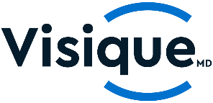

Save on prescription eyewear!
Shop at FYidoctors®, BonLook®, or Visique® and enjoy discounts* on eyewear!
Ways to shop:
in person at any of the 300+ locations across Canada (present your physical or digital benefits card to show you’re a Manulife group benefits member)​
online through the Manulife Mobile app or plan member site
22% off regular priced frames and lenses​
12% off regular priced contact lenses​
an additional 5% off other promotions (excluding contact lenses)
*Offer valid until May 30, 2028. Offer subject to change without notice.

Slide 4
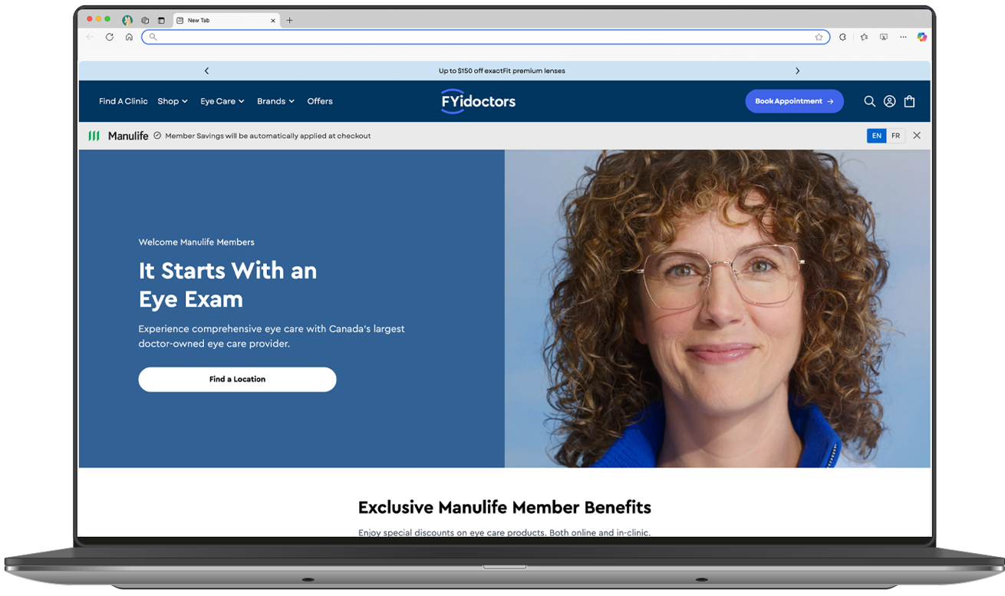
It all starts with an eye exam
clinics are doctor-owned and doctor-led​
over 300 locations from coast to coast, and growing​
eye care professionals to help you choose glasses for the first time, transition to bifocal or progressive lenses, or find specialized eyewear for sports or work​
access to vision health tips to learn more about protecting your overall eye health​
Screenshots shown are for illustrative purposes only and the actual product may differ.

Slide 5

Protect your vision with regular eye exams
Did you know?
Regular eye exams can help detect early signs of chronic conditions such as diabetes and hypertension.¹​
In Canada, it’s recommended to have eye exams every 1-2 years for adults (more frequently for those with diabetes) and every year for children.²
Due for an eye exam? Looking for an optometrist?
Conveniently book your next appointment through the Manulife Mobile app or plan member site!​
Don’t forget to check your coverage details to see if and how often your eye exams are covered (as benefits plans can vary).
¹ Canadian Association of Optometrists, Eye exam vs. sight test: What is the difference?, March 2023.
² Canadian Association of Optometrists, The eye exam, March 2023.

Slide 6


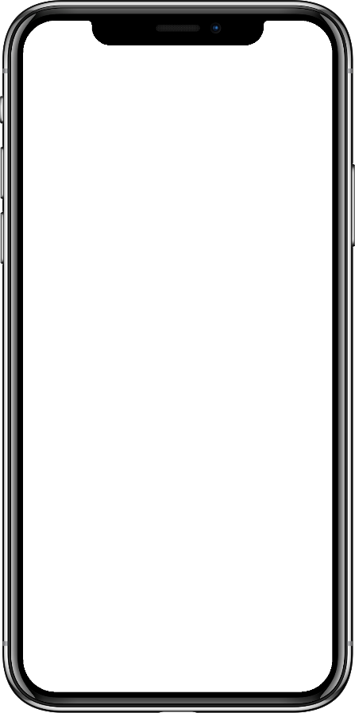
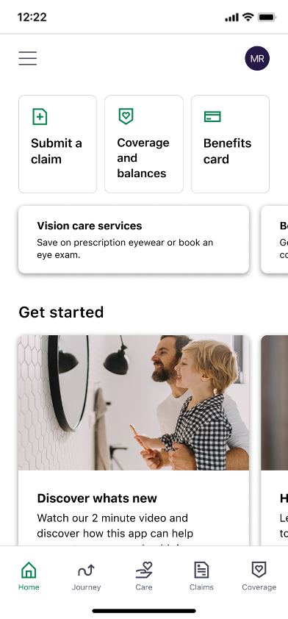
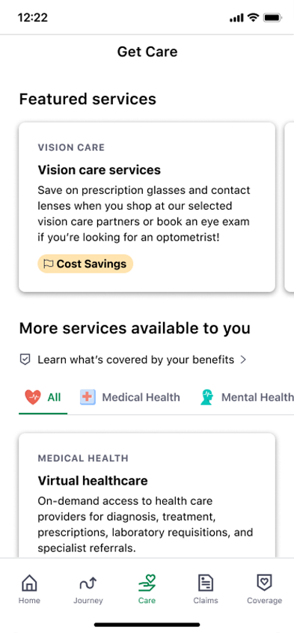
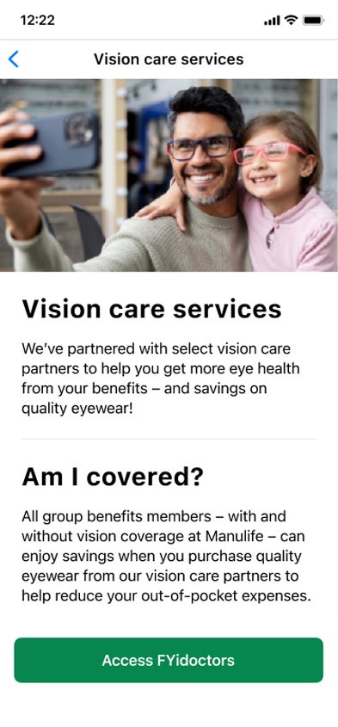

Simple steps to vision care
2
1
3
1. From the ​Manulife Mobile app home screen, tap on the ‘Vision care services’ tile at the top or ‘Care’ at the bottom of ​the screen.
2. From the ‘Get care’ page, select ‘Vision care services’.​
3. To begin, click ​on ‘Access FYidoctors’.
Check your coverage details and balances under the ‘Coverage’ tab if you have vision coverage at Manulife.​
Screenshots shown are for illustrative purposes only and the actual product may differ.
6
6

Slide 7

Prioritize your eyes
Head to the Manulife Mobile app or plan member site to learn more.
With a group benefits plan powered by Manulife, ​every action can help build towards a healthier future.​

Slide 8
Thank you

Slide 9
FYidoctors and Visique are registered trademarks of FYI Eye Care Services and Products Inc.​
BonLook is a registered trademark of BonLook Inc​
The Manufacturers Life Insurance Company (Manulife)​
Group Benefit products and services are offered by The Manufacturers Life Insurance Company (Manulife). Manulife, Stylized M Design, and Manulife & Stylized M Design are ​trademarks of The Manufacturers Life Insurance Company and are used by it, and by its affiliates under license. ©2025 The Manufacturers Life Insurance Company. All rights reserved. ​Manulife, PO Box 2580, STN B Montreal QC H3B 5C6.

